Slide 1
Space Inspection for CubeSats and Other Space Targets using Object Detection in Images
Anh Quoc Nguyen and Donghoon Kim
2023 AAS/AIAA Space Flight Mechanics Meeting
Austin, Texas, Jan 15-19, 2023

Slide 2
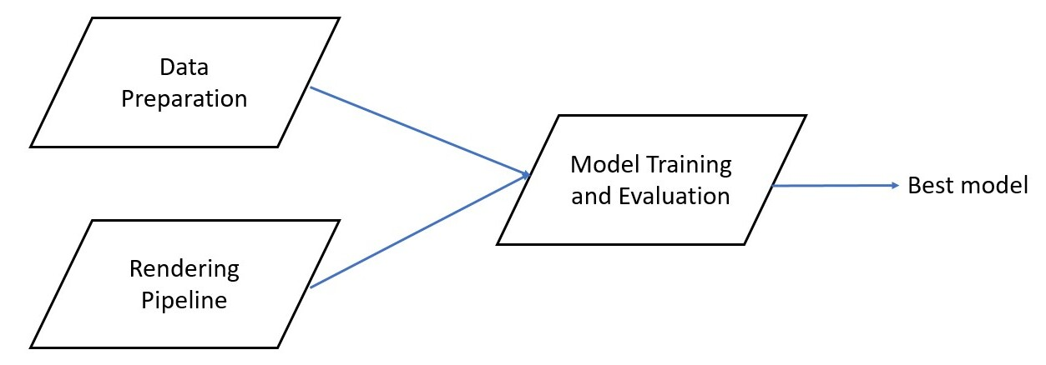
Outline
Problem introduction
Previous works
Data Preparation
Rendering Pipeline
Model Training and Evaluation
Object Detection
Domain Adaptation
Results and Discussion
Future Works
Conclusion

Slide 3
*Problem Introduction
For the purposes of all close-proximity operations between space objects, like rendezvous, docking, space debris capturing, and asteroid landing,
==> One would hope to develop a computer vision model to detect all man-made objects in space.
Challenges:
Limited computation capability
Lack of data, both labelled and unlabeled
Notes:
Limited processing capability, smaller computers, due to size, weight, power intake, radiation tolerance and fault tolerance
Lack of data: For supervised, object detection labels much effort. For unsupervised, semi-supervised, self-supervised, lack of data with space objects in them.
Data present are from marketing material and launch recordings, single angle, same quality --> Bad model

Slide 4
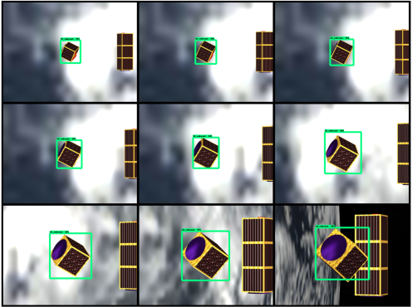
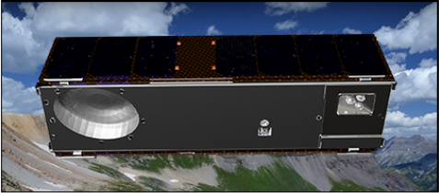
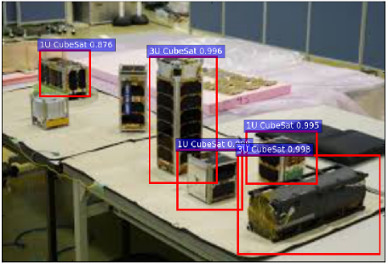
* Previous works
2. Random Background²
Unrealistic Redundant Render¹
3. Undeployed Space Objects Samples³

Slide 5
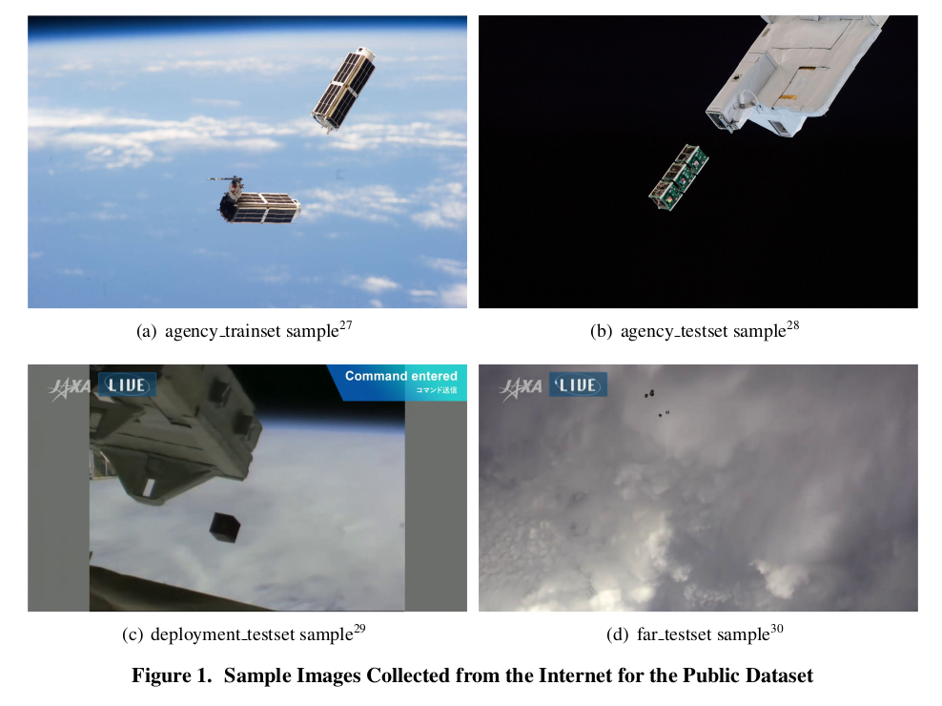
Dataset Preparation: First Public Real Dataset
Notes:
The 3 test sets and 1 train set. Agency_testset contains miscellanious images, various angles. Far_testsets from JAXA point camera downward, with earth atmosphere and land as the background. Deployment_testset are from international space station set angles. Also has unlabeled images and sequences for the purpose of domain adaptation. Will be accessible to the public.

Slide 6
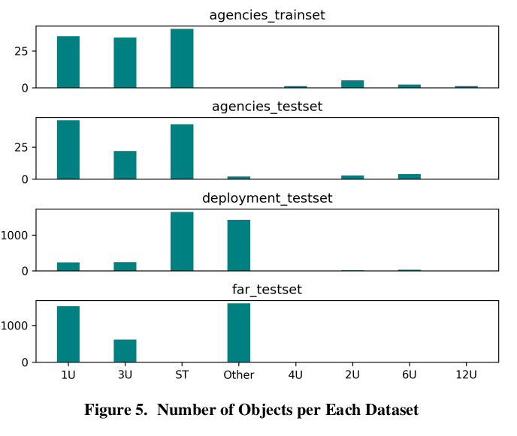
Dataset Preparation: Real Dataset Distribution
Label list:
CubeSats: 1U, 2U, 3U, 4U, 6U, 12U
Space Targets: ST
Other

Slide 7
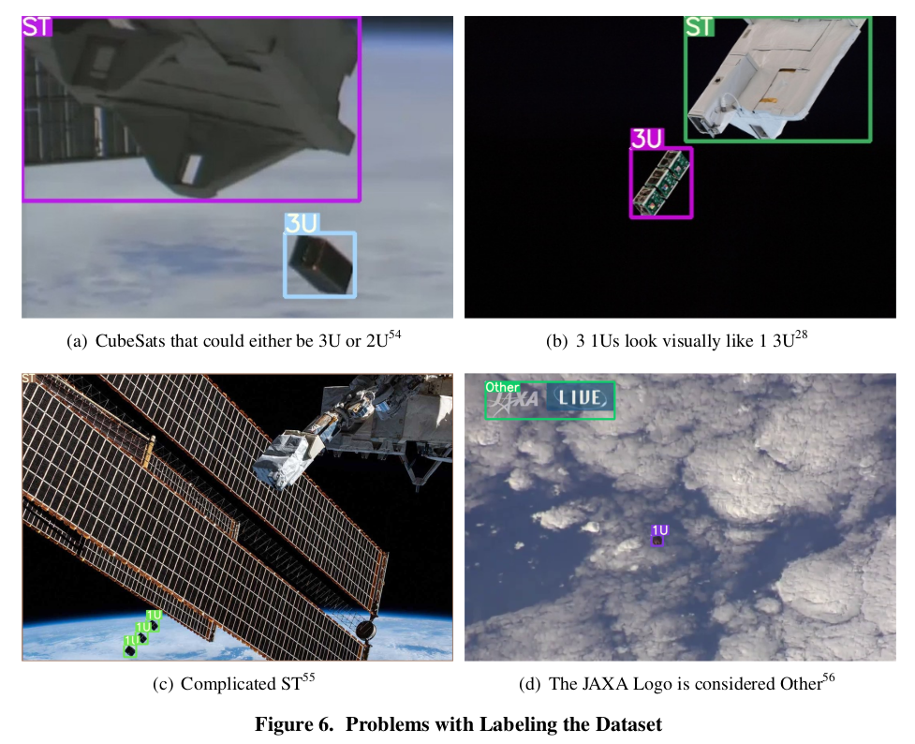
Dataset Preparation: Issues

Slide 8
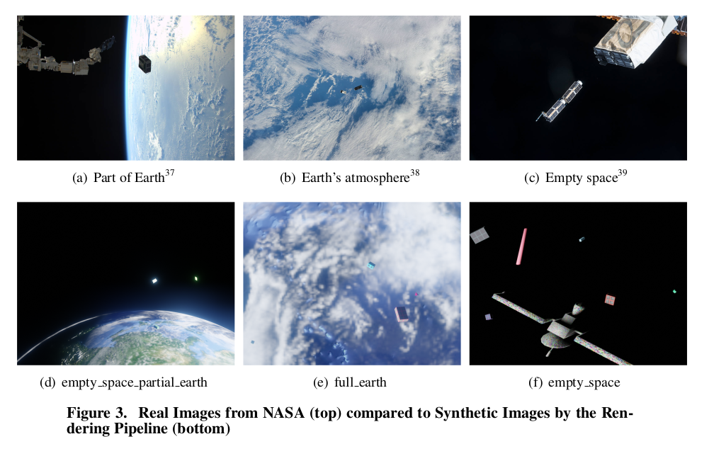
2. Rendering Pipeline: Samples

Slide 9
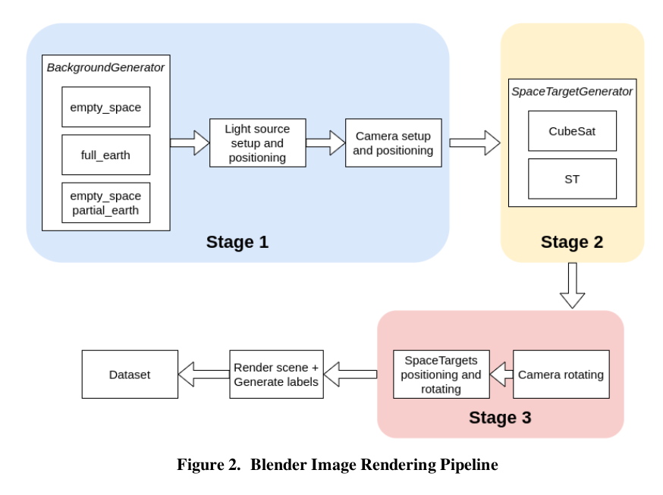
2. Rendering Pipeline: Architecture
For accuracy: As closed to reality as possible
For generalizability: As diverse as possible

Slide 10
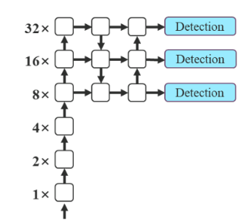
3. Model Training and Evaluation: Object Detection and YOLOv7
Object Detection outputs: Location of Bounding boxes, Confidence score, and Object Class probability
YOLOv7 is a state-of-the-art real time object detection*
==> Considering the trade-off between accuracy, speed and weight, YOLOv7 is chosen for experimentation
* YOLOv7⁶ reached 51.4% mAP (mean Average Precision) on COCO testset, at 161 FPS on a V100 GPU. YOLOv7-Tiny reached 286 FPS, but suffered about 20% decrease in mAP
YOLOv7 default architecture

Slide 11
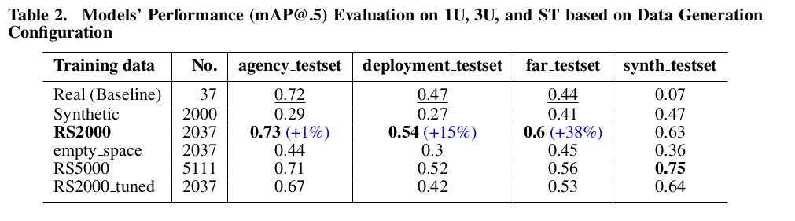
3. Model Training and Evaluation: Pipeline Configuration
Compare the performance of model trained on the same conditions but different dataset:
1. Value of synthetic data
Baseline : 37 real images from NASA
Synthetic : 2,000 synthetic images
RS2000 : 2,000 synthetic + 37 real images
2. Generation mode
empty_space : 2,000 empty space background
3. Number of training samples
RS5000 : 5,000 synthetic + 111 real images
4. Tuning RS2000*
RS2000_tuned: 2,000 synthetic + 37 real images
* with adding training image weights, training on multiple scales of the input, evolving hyper-parameters, and adding more data augmentation
Notes:
Conclude

Slide 12
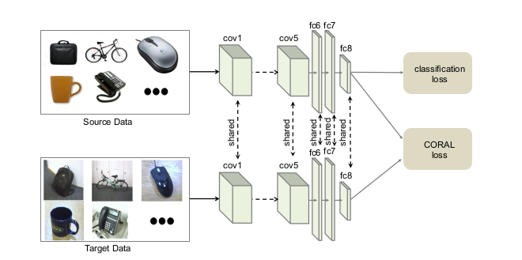
3. Model Training and Evaluation: Domain Adaptation (DA)
Deep CORAL (CORrelation ALignment)⁸: the distance between the second-order statistics (covariances) of the source and target features.
CMD (Central Moment Discrepancy)⁹: the distance between the higher-order moments of the source and target features.

Slide 13
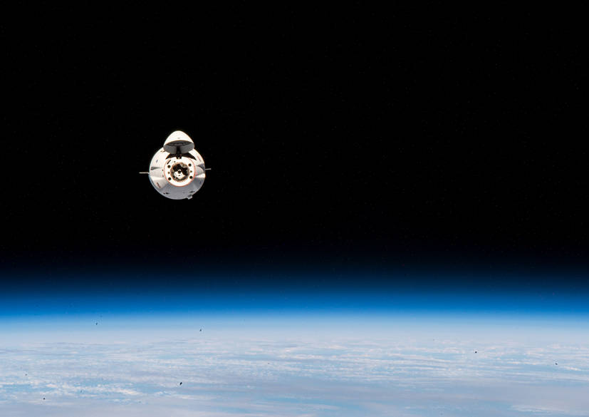
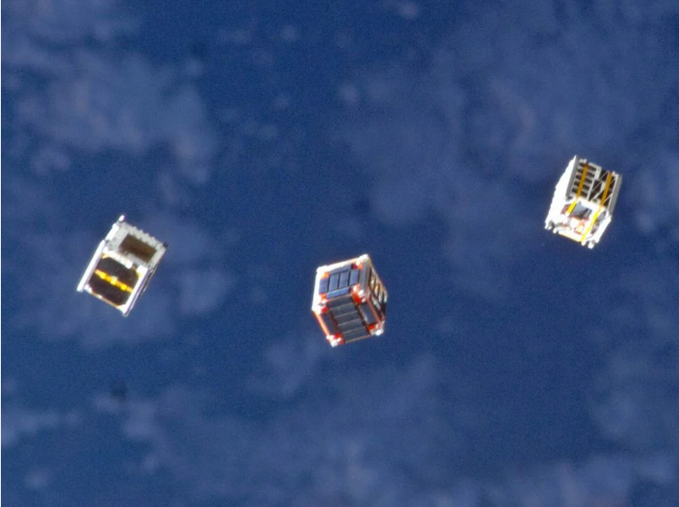
3. Model Training and Evaluation: DA
Annotation
: Downsampling Block
: Upsampling Block
: SPPCSPC
: RepConv Block
Unlabeled data (Target Domain)
Domain Adaptation Loss (L3)
Domain
Adaptation
Loss (L1)
Domain
Adaptation
Loss (L3d)
Box + Class + Objectness Loss
Backbone
Head
Detection Head
Labeled data (Source Domain)
Detection Head
Detection Head

Slide 14
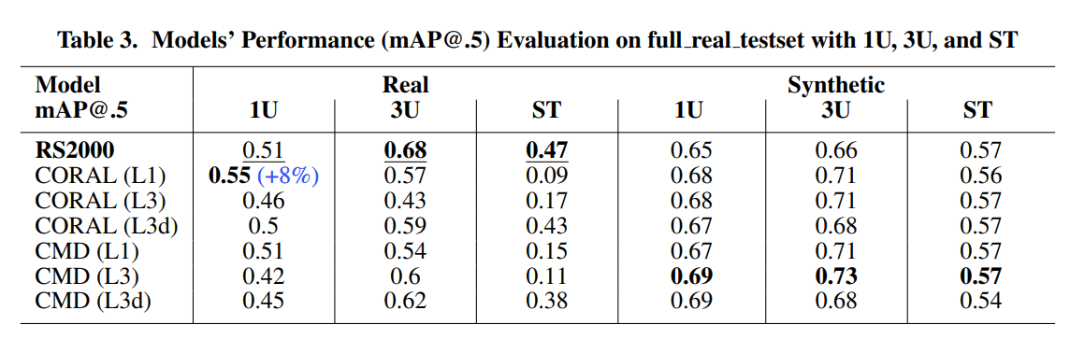
3. Model Training and Evaluation: DA Evaluation

Slide 15
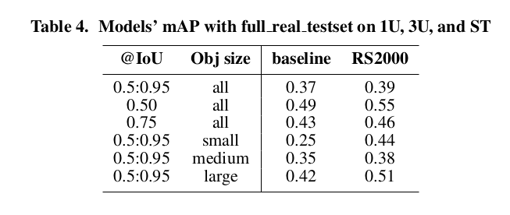
3. Model Training and Evaluation: Comparison

Slide 16
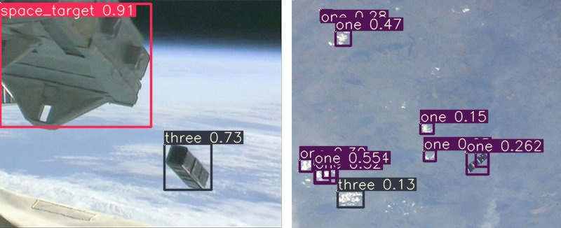
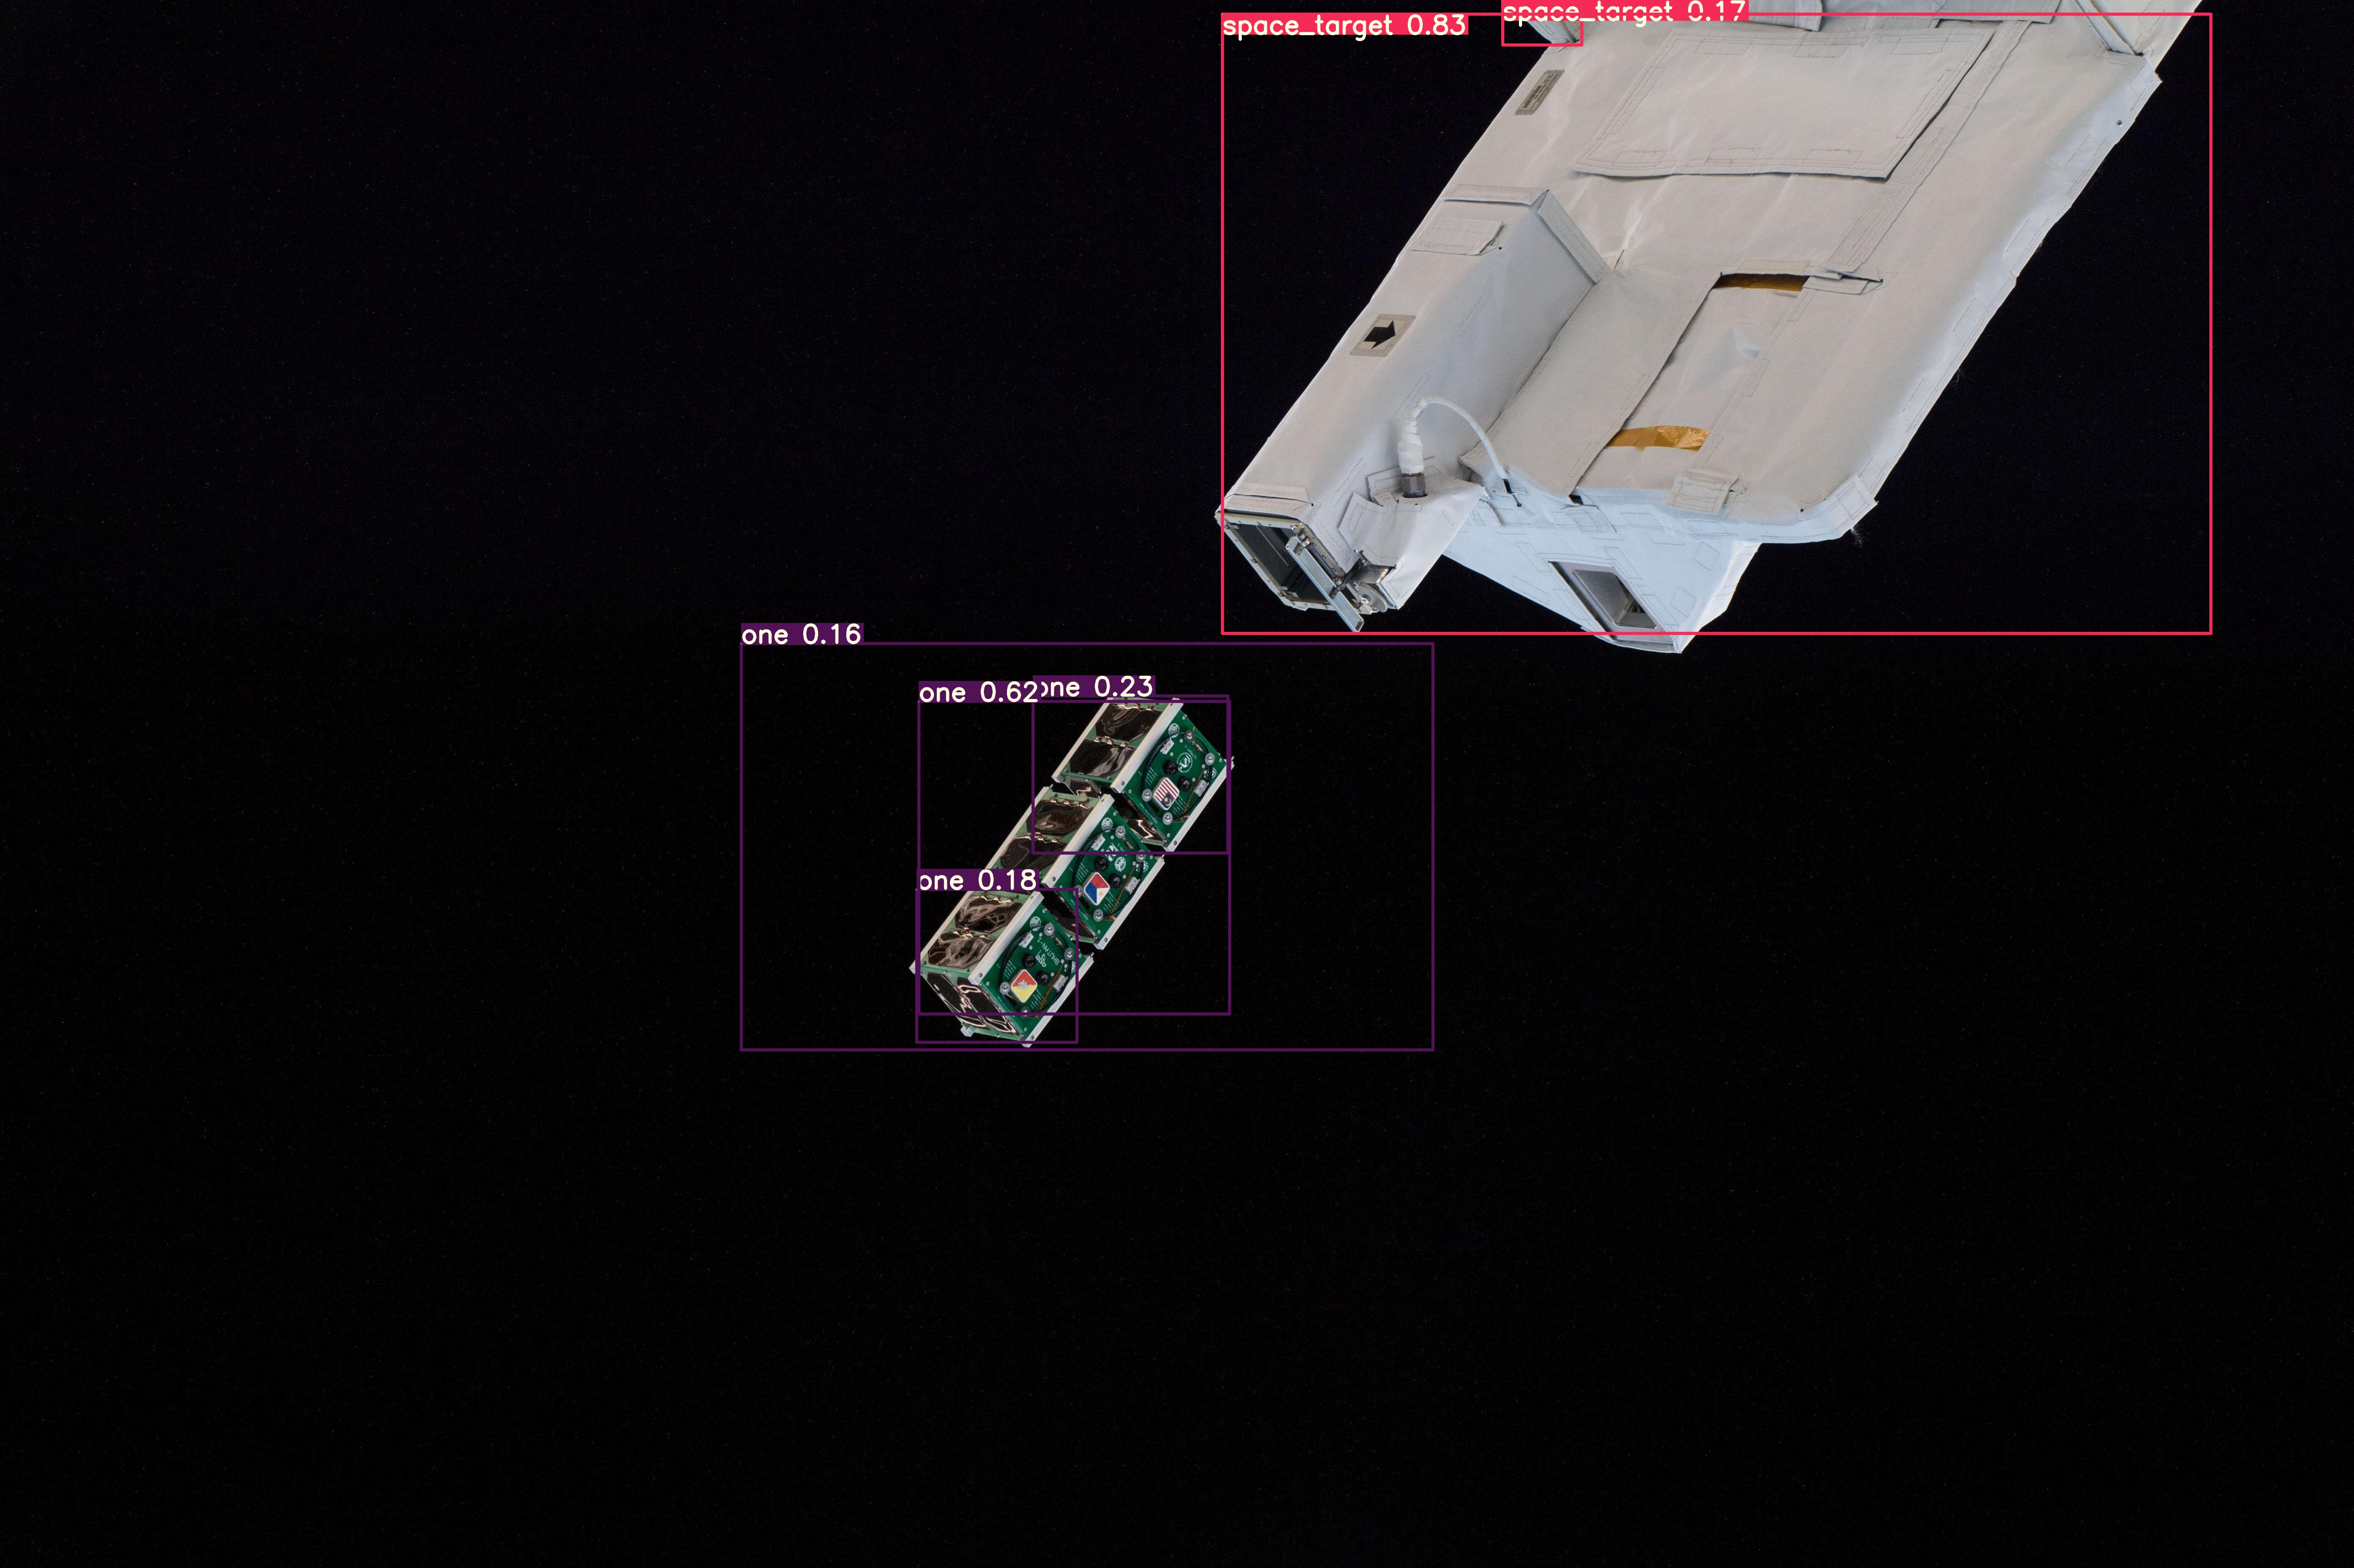
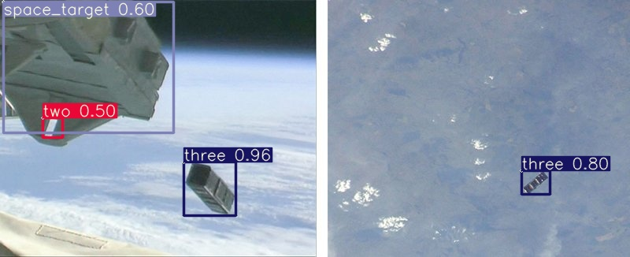
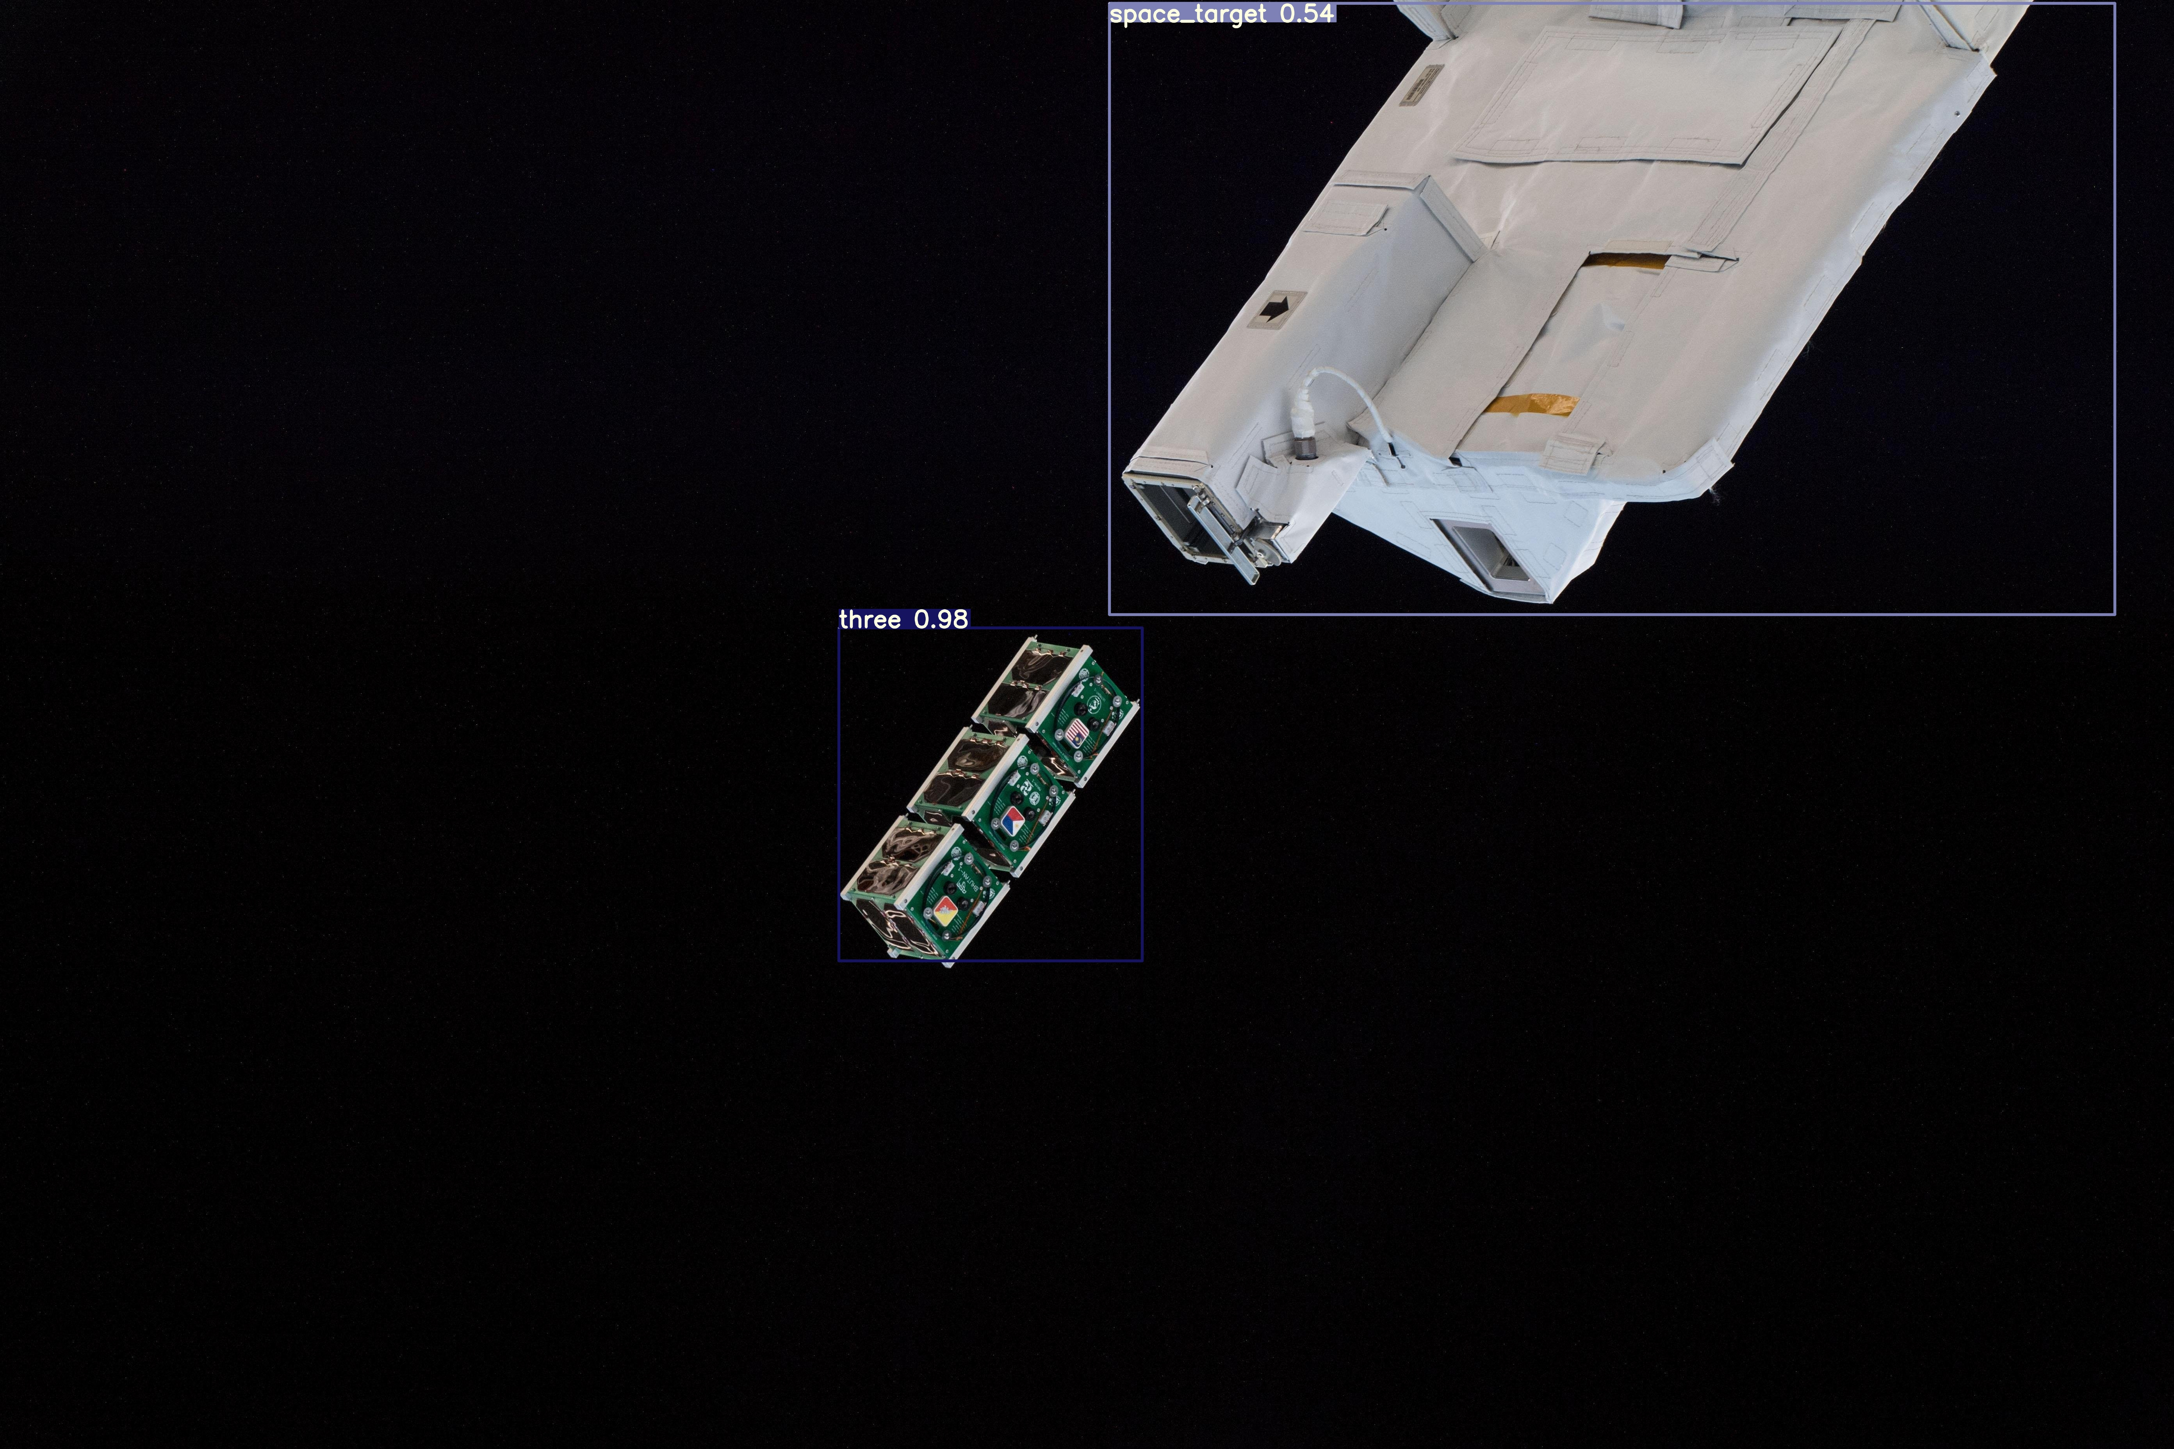
3. Model Training and Evaluation: Comparison samples
Baseline
RS2000
Notes:
Baseline: For false predictions
RS2000: More generalization, thanks to background in the data

Slide 17
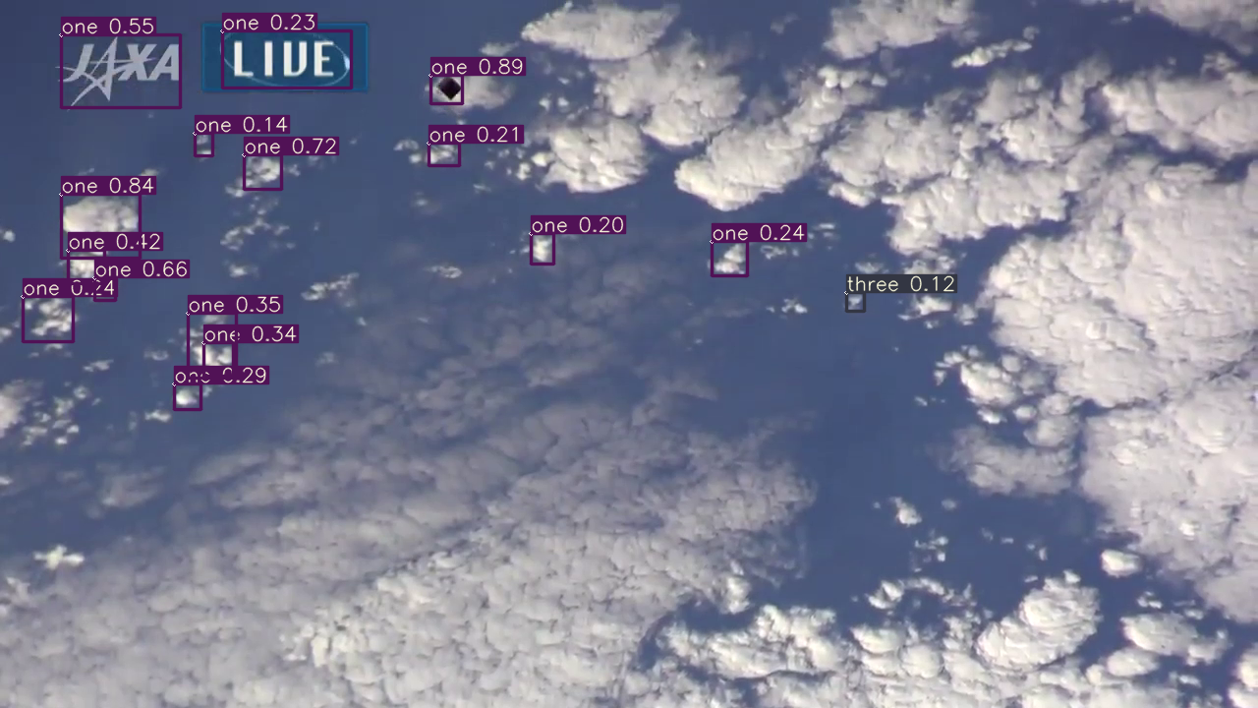
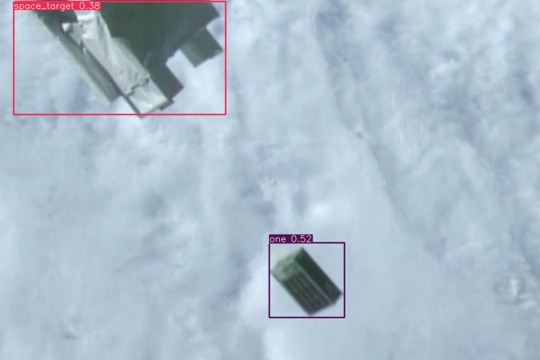
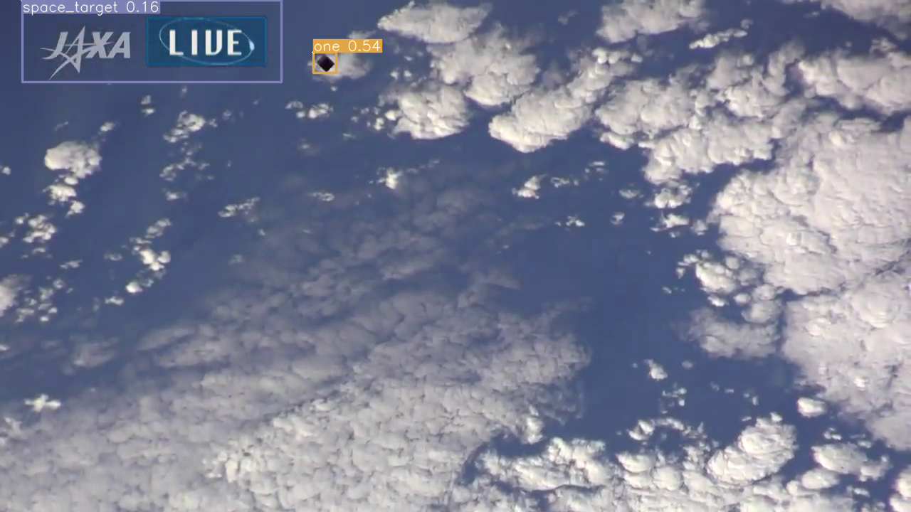
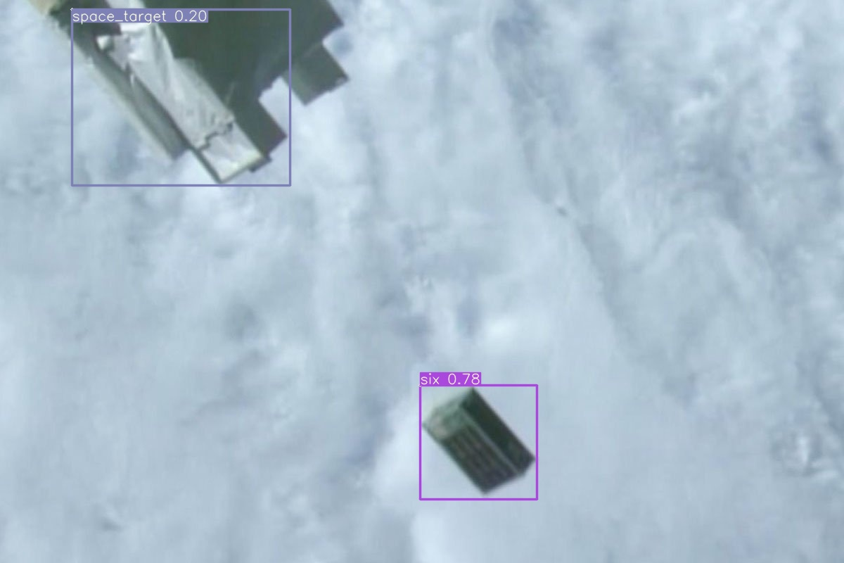
3. Model Training and Evaluation: Comparison samples
Baseline
RS2000

Slide 18
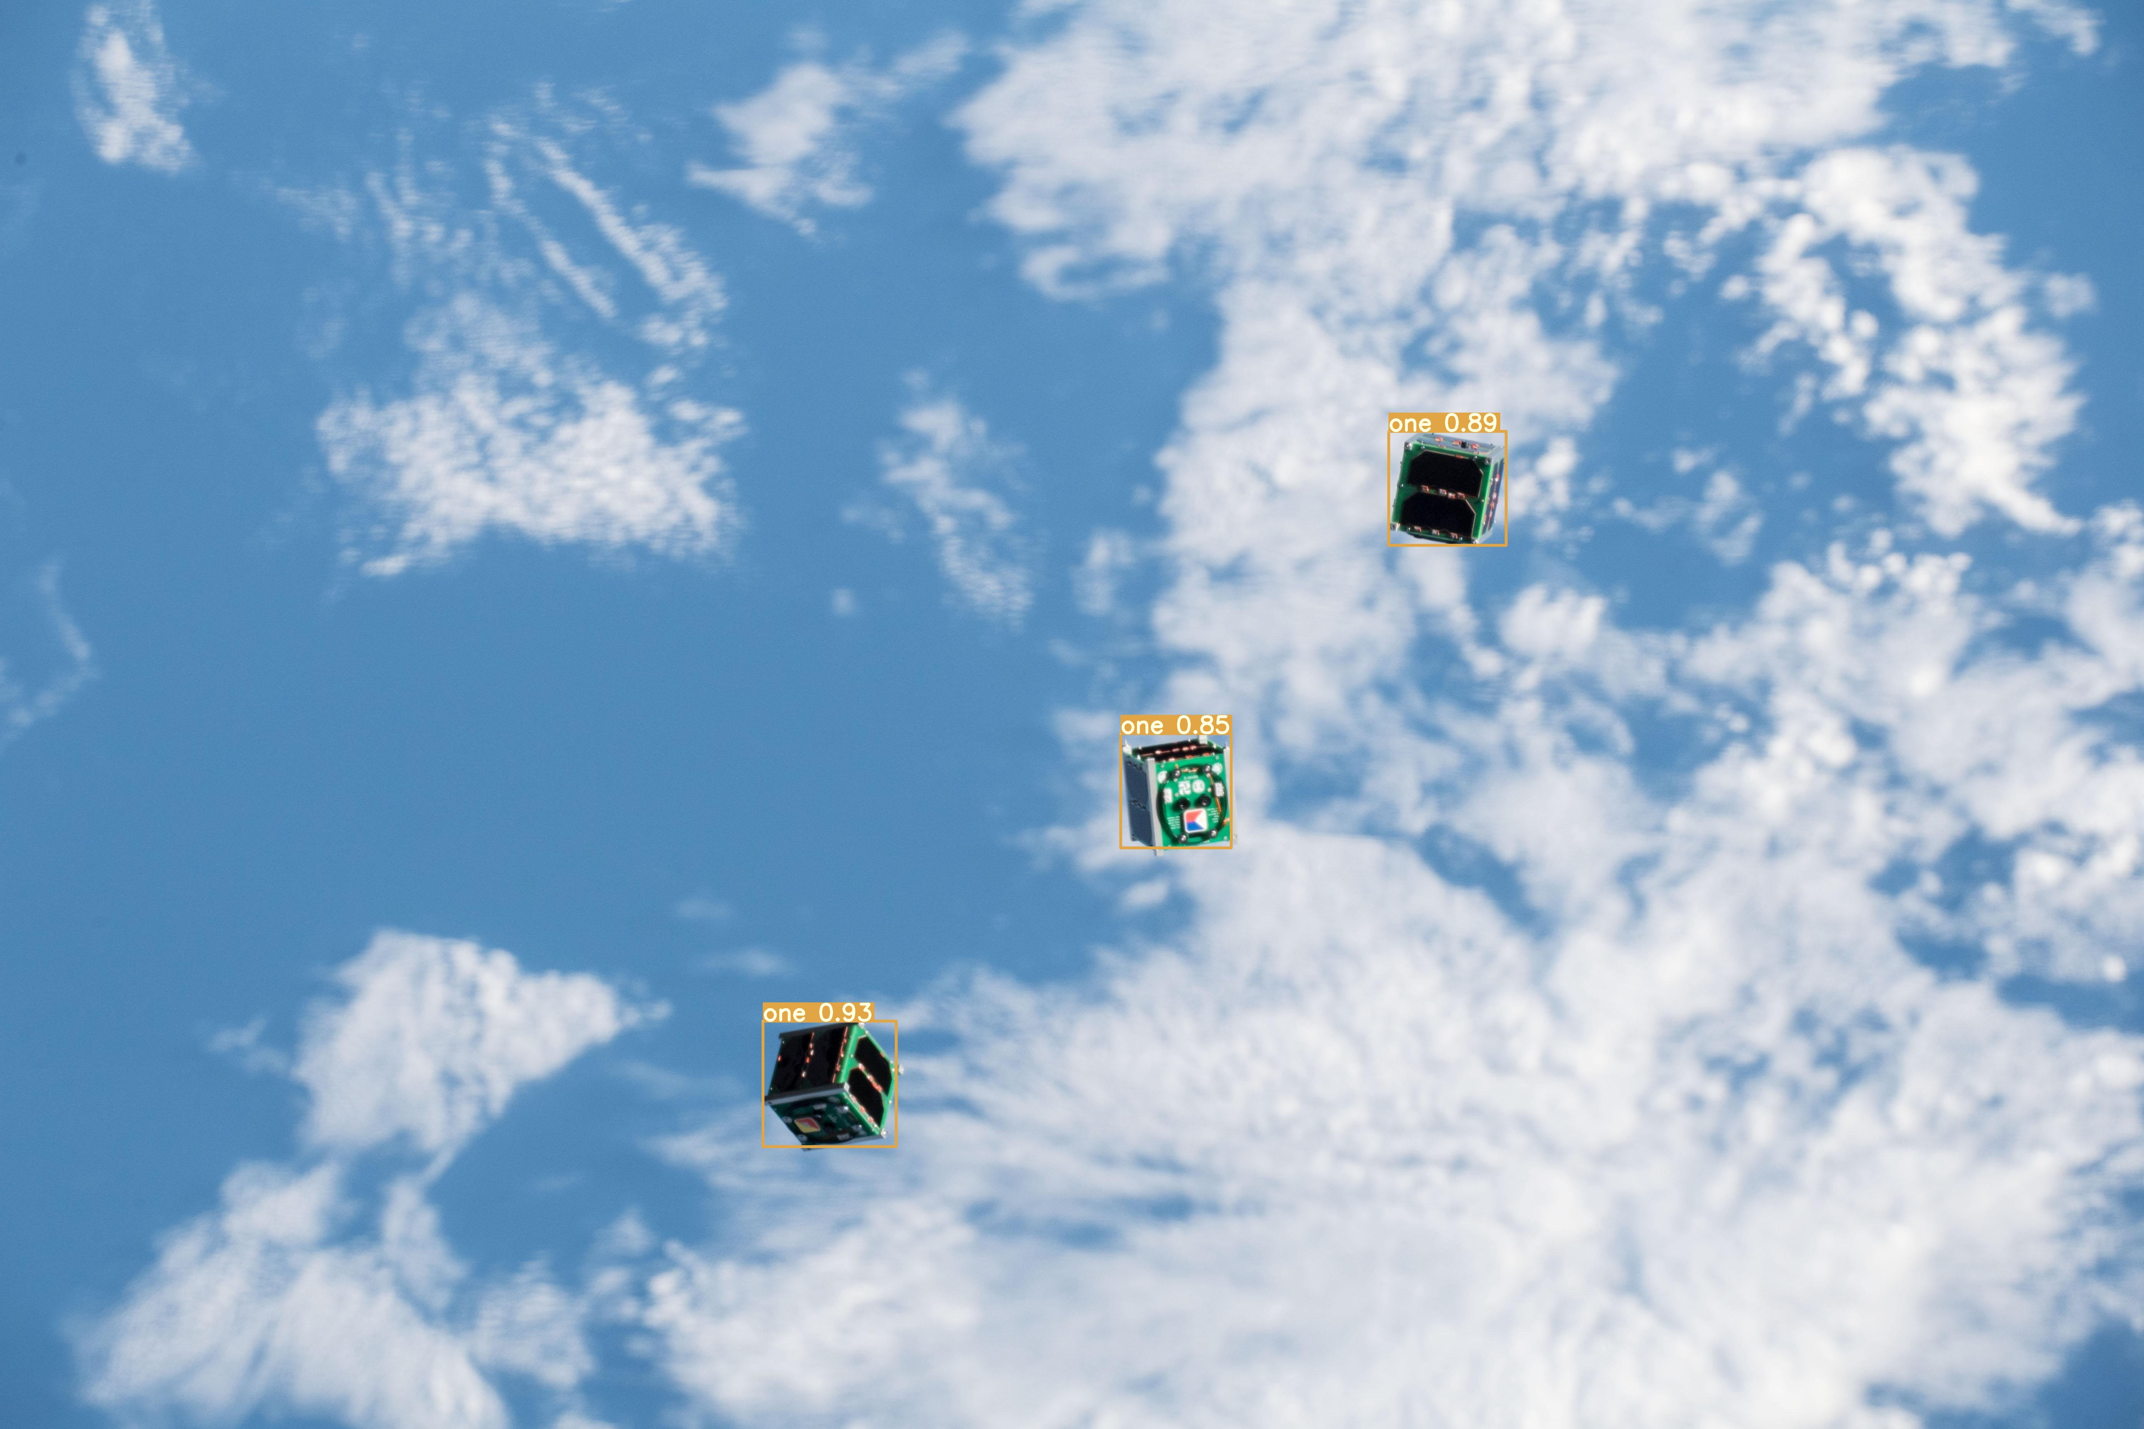
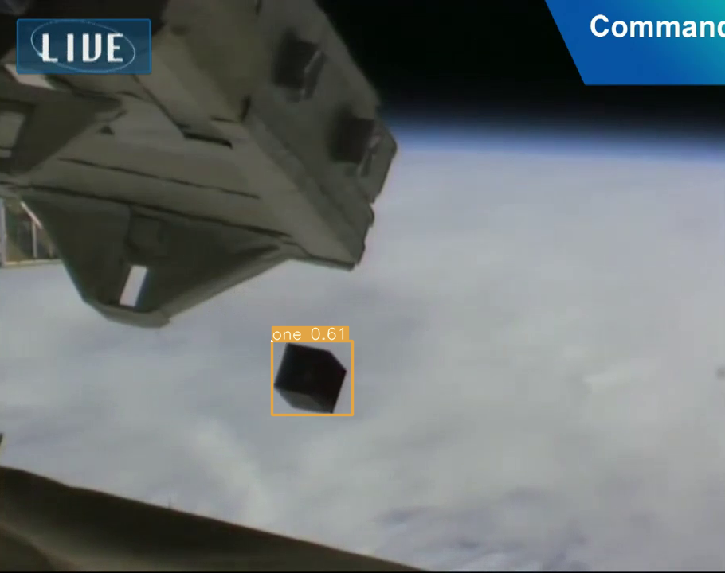
3. Model Training and Evaluation: Samples

Slide 19
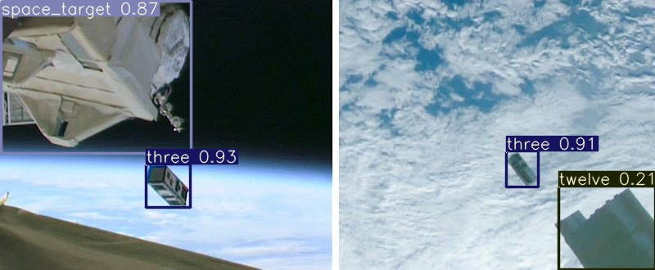
3. Model Training and Evaluation: Samples

Slide 20
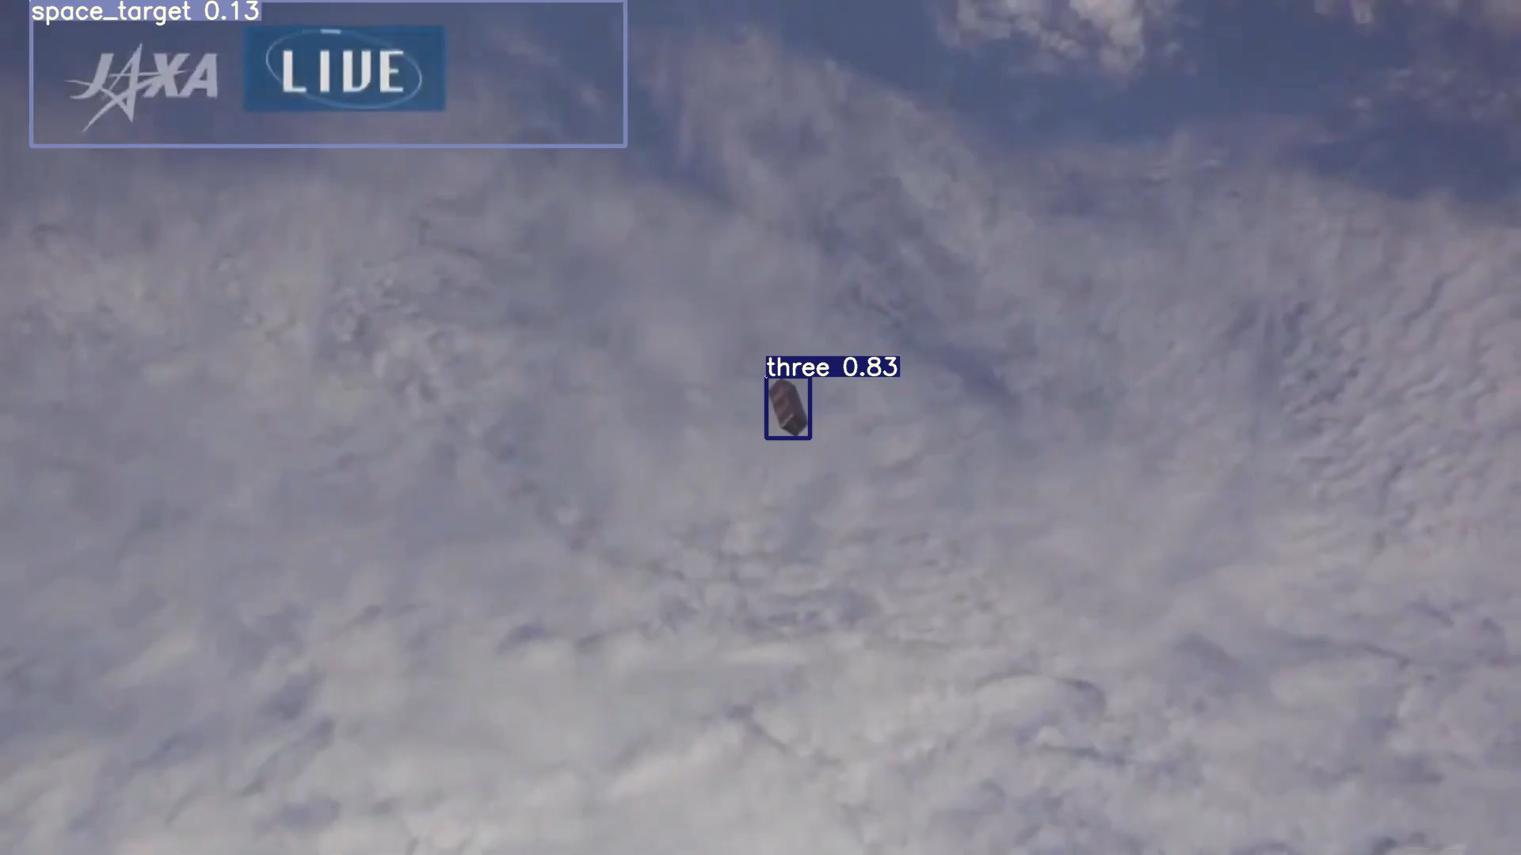
3. Model Training and Evaluation: Samples

Slide 21
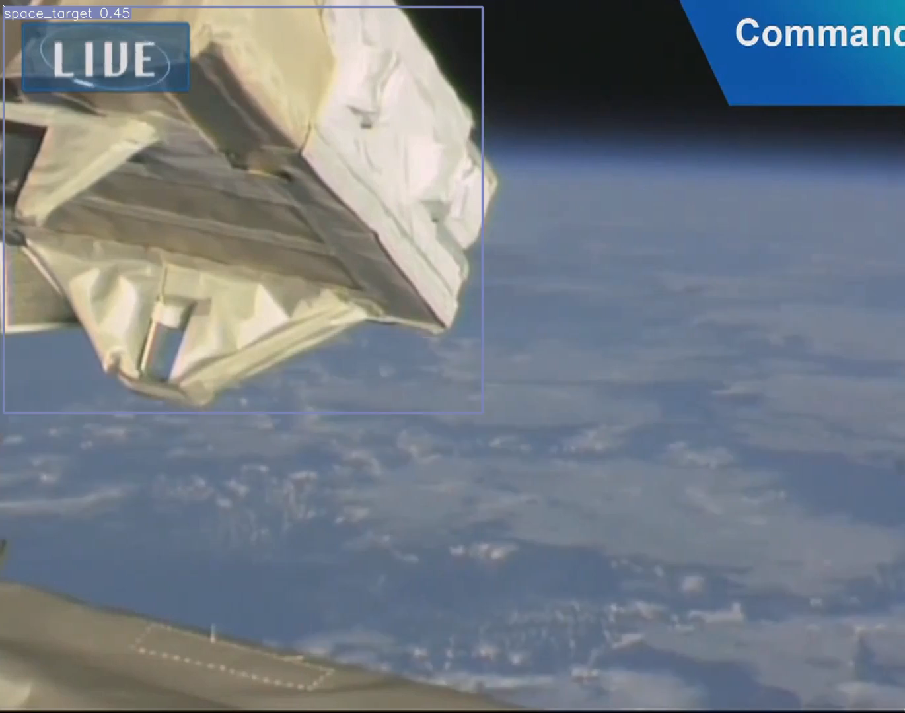
3. Model Training and Evaluation: Samples

Slide 22
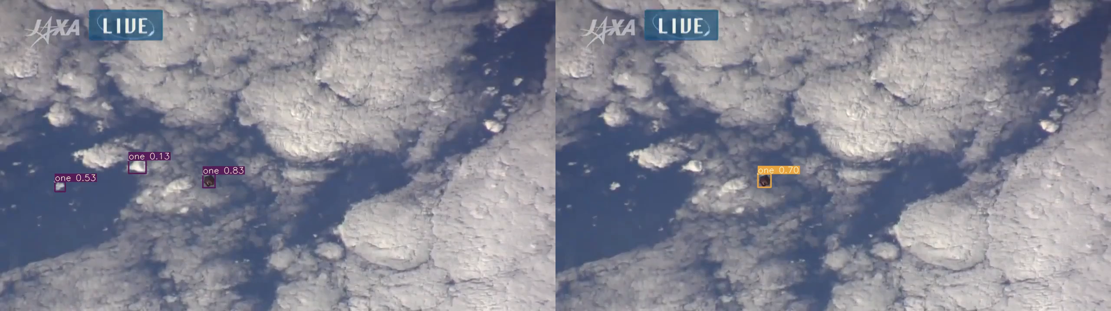
3. Model Training and Evaluation: Comparison
Baseline
RS2000

Slide 23
*Conclusion
This research's contributions:
Released a public dataset of labelled and unlabeled data for future research. Examined the inherent challenges to Space Inspection.
Designed an image rendering pipeline to generate diverse and realistic training data for to detect all man-made objects in space.
Demonstrated that state-of-the-art object detection models can be used to detect objects in space using both synthetic and real data.
Experimented with statistical domain adaptation approaches and found that CORAL loss increased the model performance on the 1U CubeSat class

Slide 24
*Future works
Potential Domain Adaptation methods can utilize large amount of synthetic data
Non-generative Adversarial Training: Domain Adversarial Neural Network attached to backbone or detection heads, can be used to classify both domains and background.
Encoder-Decoder Reconstruction: Decoder can be attached to the end of backbone to reconstruct the input.
=> Encourage YOLOv7 to extract domain-invariant features.

Slide 25
Thank you for your attention. Questions?

Slide 26
References
[1] J.-F. Shi, S. Ulrich, and S. Ruel, CubeSat Simulation and Detection using Monocular Camera Images and Convolutional Neural Networks, 10.2514/6.2018-1604.
[2] J. Aarestad, A. Cochrane, M. Hannon, E. Kain, C. Kief, S. Lindsley, and B. Zufelt, “Challenges and
Opportunities for CubeSat Detection for Space Situational Awareness using a CNN,” 2020.
[3] S. N. G. I. Samarawickrama, Faster R-CNN based CubeSat close proximity detection and attitude esti-
mation in the Department of Aerospace Engineering. 2019.
[6] C.-Y. Wang, A. Bochkovskiy, and H.-y. Liao, “YOLOv7: Trainable bag-of-freebies sets new state-of-
the-art for real-time object detectors,” 07 2022, 10.48550/arXiv.2207.02696.
[8] B. Sun and K. Saenko, “Deep CORAL: Correlation Alignment for Deep Domain Adaptation,” Com-
puter Vision – ECCV 2016 Workshops (G. Hua and H. Jégou, eds.), Cham, Springer International Pub-
lishing, 2016, pp. 443–450.
[9] W. Zellinger, T. Grubinger, E. Lughofer, T. Natschläger, and S. Saminger-Platz, “Central Moment Dis-
crepancy (CMD) for Domain-Invariant Representation Learning,” 2017, 10.48550/ARXIV.1702.08811.

Slide 27
References
[20] A. Krizhevsky, I. Sutskever, and G. E. Hinton, “ImageNet Classification with Deep Convolutional Neural Networks,” Proceedings of the 25th International Conference on Neural Information Processing Systems - Volume 1, NIPS’12, Red Hook, NY, USA, Curran Associates Inc., 2012, p. 1097–1105.
[27] “File:ISS-38 NanoRacks CubeSat Deployment Iss038e044916.jpg,” https://commons.wikimedia.org/wiki/File:ISS-38_NanoRacks_CubeSat_Deployment_Iss038e044916.jpg. Retrieved: 2022-12-24.
[28] “Birds-2 deployed from Kibo (Iss056e130478).jpg,” https://commons.wikimedia.org/wiki/File:Birds-2_deployed_from_Kibo_(Iss056e130478).jpg. Retrieved: 2022-12-24.
[29] “Small Satellites Deployment J-SSOD no16 from ”Kibo” (OPUSAT-II, BIRDS-4, RSP01,WARP01, timestamp 1:05:49),” https://www.youtube.com/watch?v=Yt26Z1EJIDc. Retrieved: 2022-12-24.
[30] “Small Satellites Deployment J-SSOD no16 from ”Kibo” (OPUSAT-II, BIRDS-4, RSP01,WARP01, timestamp 38:19,” https://www.youtube.com/watch?v=Yt26Z1EJIDc. Retrieved: 2022- 12-24.
[54] “Three CubeSats successfully deployed from ”Kibo”!,” https://iss.jaxa.jp/en/kiboexp/news/1810_cubesat10_en.html. Retrieved: 2023-1-1.
[55] “JAXA and UNISEC open of J-CUBE Program!,” https://humans-in-space.jaxa.jp/en/biz-lab/news/detail/001787.html. Retrieved: 2023-1-1.
[56] “Small Satellites Deployment J-SSOD no16 from ”Kibo” (OPUSAT-II, BIRDS-4, RSP01,WARP01,
timestamp 1:07:22),” https://www.youtube.com/watch?v=Yt26Z1EJIDc. Retrieved:2022-12-24.

